Slide 1

APPLIED MACHINE LEARNING FOR TEXT ANALYSIS · 24ALT3101
Explainable Transformer-Based
Emotion-Aware Customer Feedback Analysis
28 emotion labels
Segment-aware scoring
SHAP explanations
4 business buckets
In the Guidance of
Dr. KANTANGURI SWANTHANA
Notes:
Title slide. Course: Applied Machine Learning for Text Analysis (24ALT3101). The one-line framing: this is a decision-support tool, not a black-box sentiment score.

Slide 2
01 · PROBLEM STATEMENT
Coarse labels hide what customers actually said
Four failure points in conventional sentiment analysis of customer feedback.
01
Three labels aren't enough
ONE REVIEW, TWO EMOTIONS
Positive / negative / neutral never names the emotion behind the feedback.
“Delivery was fast and the packaging was perfect, but the battery drains within two hours.”
02
Mixed reviews get averaged away
SEGMENT 1
Satisfaction
One review can praise and complain; a single whole-review score erases both.
admiration · gratitude
03
Black-box output isn't trusted
SEGMENT 2
Frustration
disappointment · annoyance
Stakeholders cannot see why a prediction was made, so they cannot rely on it.
04
Fine-grained still isn't actionable
Whole-review score would read “neutral” — both signals lost.
Even 28 raw emotion labels need a business translation before anyone acts.
Illustrative example.
2
Notes:
Walk the example: the review flips at 'but'. Whole-review scoring cancels the two halves out; segment-level scoring keeps both. This example is illustrative, not a model output.

Slide 3
02 · OBJECTIVES
What we will build, and how we will know it is done
Six objectives, each with the check that closes it.
01
Train a multi-label classifier
02
Calibrate every label separately
03
Score reviews clause by clause
Fine-tune RoBERTa-base over 27 GoEmotions emotions plus neutral, with BCE loss so co-occurring emotions never compete.
Tune a decision threshold per emotion on validation data instead of applying one global 0.5 cutoff to all 28.
Split on sentence boundaries and contrastive connectives so praise and complaint in one review stay separate.
Done when: macro and micro F1 are reported on a held-out test split.
Done when: thresholds.json ships inside the model artifact.
Done when: a mixed review returns both verdicts and a mixed flag.
04
Explain each prediction
05
Aggregate into business terms
06
Deliver a working system
Return SHAP token attributions identifying which words pushed each emotion score up or down.
Roll the 28 labels into satisfaction, frustration, confusion and concern, with neutral reported separately.
REST APIs, a React dashboard, asynchronous batch CSV processing and explicitly documented limitations.
Done when: /api/explain returns attributions for any review.
Done when: the dashboard reports four bucket percentages.
Done when: the full stack runs end to end under Docker Compose.
3
Notes:
Do not read all six aloud. Group them: one and two are the model — a multi-label classifier that is then calibrated per label. Three, four and five are what makes the output usable — clause-level scoring, token-level explanation, business aggregation. Six is delivery. The value of this slide is the second line in each card: every objective has a check that closes it, so 'done' is not a matter of opinion.

Slide 4
03 · LITERATURE SURVEY
What the field established, and what it left open
Six papers in five rows — four supply data and task formulation, two supply method.
PAPER
VENUE / YEAR
KEY CONTRIBUTION
WHAT IT LEAVES OPEN
WHERE IT ENTERS OUR SYSTEM
GoEmotions — Demszky et al.
ACL · 2020
58k Reddit comments hand-annotated over 27 emotions plus neutral — the largest fine-grained emotion corpus
Reddit domain; one global threshold; whole-comment scoring
Primary corpus and our 28-label space
SemEval-2018 Task 1 — Mohammad et al.
SemEval · 2018
Established multi-label emotion classification as a shared benchmark with per-label evaluation
Tweet-specific 11-label taxonomy; no explanation component
Justifies our multi-label BCE setup; its corpus was tested and rejected
CARER & DailyDialog — Saravia; Li et al.
EMNLP 2018 · IJCNLP 2017
Large-scale emotion labelling on tweets and on multi-turn dialogue, over 6 and 7 classes
Coarse single-label taxonomies that cannot express co-occurring emotions
Coverage-masked auxiliary corpora, off by default
RoBERTa — Liu et al.
arXiv · 2019
Showed BERT was undertrained; a robust pretraining recipe giving stronger transfer at 125M parameters
A general backbone — no emotion-specific modelling
The encoder we fine-tune with a multi-label head
SHAP — Lundberg & Lee
NeurIPS · 2017
Unified additive feature attribution built on Shapley values; model-agnostic explanations
Normally run offline over samples, not inside a serving path
Token attributions on every prediction, cached
The gap this project fills: no single work combines fine-grained emotion labels, per-label calibration, segment-level scoring and explanation inside the serving loop.
All open access — ACL Anthology, SemEval, NeurIPS and arXiv. Click a venue to open the paper.
4
Notes:
Structure the survey as two halves. The first three rows are data and task: GoEmotions gives the corpus and the 28-label space, SemEval-2018 establishes multi-label emotion classification as a benchmark task, and CARER and DailyDialog supply auxiliary supervision at a coarser granularity. The last two rows are method: RoBERTa is the encoder, SHAP is the explanation technique. Then land the footer — every column has a 'leaves open' entry, and no single paper closes all of them at once. That combination is the gap, and it leads directly into the next slide.

Slide 5
04 · DATASETS & DIFFERENTIATOR
Every corpus, its limits, and what we changed
Five corpora considered — one trained on, two held in reserve, one rejected, one never trained on.
DATASET
YEAR
PAPER / SOURCE
KEY LIMITATION
HOW OUR MODEL RESPONDS
GoEmotions
2020
arxiv.org/abs/2005.00547
Reddit comments, not product reviews; grief, pride and relief have under 20 test examples each
Fine-tuned on it, then recalibrated — per-label thresholds (0.05–0.95) replace the global 0.5 cutoff
dair-ai/emotion (CARER)
2018
aclanthology.org/D18-1404
Only 6 coarse labels, single-label, drawn from Twitter; no grief, pride or relief
Coverage-masked auxiliary corpus, off by default
SemEval-2018 Task 1 (E-c)
2018
aclanthology.org/S18-1001
Its only Parquet mirror ships stopword-stripped, case-folded text — an unnatural register for RoBERTa
Evaluated as a third auxiliary corpus and deliberately rejected
DailyDialog (roskoN mirror)
2017
arxiv.org/abs/1710.03957
Dialogue turns rather than reviews; single-label and heavily neutral-skewed
Coverage-masked and available, but off by default
Amazon Reviews (amazon_polarity)
2015
huggingface.co/datasets/fancyzhx/amazon_polarity
Binary polarity only — carries no emotion annotation at all
Inference and demo only; the domain gap is reported, never trained away
Beyond the corpora: per-label tuned thresholds, contrastive segment scoring, SHAP token evidence on every prediction and a four-bucket business roll-up — none of which any source corpus supplies.
model-v1 trains on GoEmotions alone, so the reported metrics stay reproducible from the committed config.
5
Notes:
One slide covering both the corpora and the differentiation. Read left to right on any row: what the dataset is, when it was published, where the paper lives, what it cannot do, and what our model does about that. The footer carries the model-level differences no corpus supplies at all — tuned thresholds, segment scoring, SHAP evidence and the four business buckets — and the metrics sit inside the published roberta-base band, so the gains come from calibration and system design rather than an inflated accuracy claim.

Slide 6
05 · RESEARCH GAP IDENTIFICATION
Four gaps closed, one left open
Identified gap on the left, the design response on the right.
IDENTIFIED GAP
HOW THIS PROJECT RESPONDS
Coarse sentiment labels are insufficient for business interpretation.
→
Multi-label RoBERTa across 28 emotion labels.
Whole-review classification averages away contrasting emotions.
→
Segment-level scoring around sentence boundaries and connectives.
Prediction without explanation hides what caused the decision.
→
SHAP token attributions returned with every prediction.
Fine-grained emotions are hard for stakeholders to interpret.
→
Four business buckets layered over the raw label space.
Training uses Reddit comments; inference targets product reviews.
→
Documented as an open domain gap — acknowledged, not claimed solved.
6
Notes:
Four gaps get a concrete design response. The fifth — Reddit training data versus product-review inference — is left open deliberately and recorded as a limitation.

Slide 7
06 · INNOVATION & NOVELTY
Conventional pipeline vs. this system
Five engineering decisions that separate this build from a standard sentiment pipeline.
DIMENSION
CONVENTIONAL SENTIMENT ANALYSIS
THIS PROJECT
Label space
2–3 polarity classes
28 multi-label emotions
Granularity
Whole review scored once
Segment-aware scoring
Explainability
Absent, or added post-hoc
SHAP built into the workflow
Business framing
Raw model output
Four actionable categories
System scope
A model endpoint
Inference · XAI · caching · analytics · batch
The README positions the deliverable as a capstone decision-support system — not a production system.
7
Notes:
Read down the right-hand column: label space, granularity, explainability, business framing, system scope. That is the innovation and the novelty claim in five lines. The two most likely to be questioned are per-label thresholds and contrastive segmentation, and both are deliberate design choices rather than defaults.

Slide 8
07 · CREATIVITY
The output is a workspace, not a score
How the model's output is presented so a stakeholder can use it.
1
Interactive analysis
DASHBOARD CONCEPT
illustrative
A review is explored, not reduced to one polarity value.
Satisfaction
2
Visual token explanation
Frustration
Highlighted words show what pushed each emotion up.
Confusion
3
Mixed-review detection
Concern
Praise and complaint are surfaced separately, side by side.
4
Trend-level analytics
TOKEN ATTRIBUTION
Emotion distributions, buckets and movement over time.
the
battery
drains
within
two
hours
5
A working bridge
Advanced NLP output becomes something a business can act on.
Shaded tokens carry the strongest contribution to the predicted emotion.
8
Notes:
Say clearly that the doughnut and token strip are UI concepts, not measured results. The point is the presentation layer, not the numbers.

Slide 9
08 · FEASIBILITY
The stack is specified end to end, and partly running
Every layer has a named technology; deployment is under way, not finished.
MODEL
BACKEND
FRONTEND
Python
FastAPI
React
Hugging Face Transformers
Celery
Dashboard
RoBERTa
PostgreSQL
Batch upload
SHAP
Redis
Model page
Training
Google Colab T4 GPU or a local CUDA GPU — kept separate from application deployment.
Local setup
Docker Compose brings up PostgreSQL, Redis, backend, worker and frontend reproducibly.
Deployment
Frontend is live on Vercel and the API is live on Render — the model artifact is not hosted yet, so prediction routes still return 503.
Performance
SHAP explanations are cached and inference runs off the FastAPI event loop.
Known constraints: no authentication · no database migrations · 128-token context · product-review domain gap
9
Notes:
Feasibility rests on the fact that nothing here is speculative — every layer names a technology already defined in the architecture, with Docker Compose for local reproducibility.

Slide 10
09 · PROJECT PLAN
Eight phases from literature to deployment
Sequential delivery; each phase produces an artefact the next one depends on.
PHASE 01
PHASE 02
PHASE 03
PHASE 04
Requirement & Literature
Data Preparation
Model Development
Evaluation
Finalise problem, objectives, datasets and evaluation criteria.
Prepare GoEmotions and auxiliary sets; define label maps and coverage masks.
Fine-tune RoBERTa using multi-label BCE loss.
Tune per-label thresholds and generate test metrics.
PHASE 05
PHASE 06
PHASE 07
PHASE 08
Explainability
Backend
Frontend
Testing & Deployment
Integrate SHAP token attributions with Redis caching.
FastAPI prediction, analysis, explanation, batch and analytics APIs.
React pages for Analyze, Dashboard, Batch and Model.
Run the 42-test suite, Dockerise services, deploy backend and frontend.
10
Notes:
Phases 1-2 are groundwork, 3-4 the model, 5-6 explainability and services, 7-8 the product surface and release.

Slide 11
10 · EXPECTED OUTCOME
What will exist when the project is finished
Six deliverables targeted for submission — criteria to meet, not results already claimed.
01
02
03
A calibrated classifier
Transparent explanations
Mixed-review handling
Feedback classified into 28 emotions with per-label tuned thresholds.
Token attributions returned with every prediction, cached for reuse.
Reviews carrying both praise and complaint resolved clause by clause.
04
05
06
Business-ready output
APIs and dashboard
A reproducible, documented build
Emotion buckets and trend analytics for non-technical stakeholders.
REST endpoints plus a web UI for individual and batch analysis.
Metrics from a committed config, with limitations stated openly.
12
Notes:
Frame these as acceptance criteria rather than aspirations — each one is checkable at submission.

Slide 12
11 · HIGH-LEVEL SYSTEM FLOW
From raw review to an explained, aggregated result
Customer
Review
Segmentation
RoBERTa
28-label model
SHAP
Explanation
Business
Buckets
→
→
→
→
raw text input
split on connectives
multi-label scoring
token attributions
4-way aggregation
OUTPUT
emotion scores
predicted labels
mixed-review flag
explanation
analytics
SUPPORTING SERVICES
PostgreSQL
Redis
Celery
persistent storage for reviews, results and analytics
SHAP explanation cache and task queue backing
asynchronous workers for batch CSV processing
13
Notes:
Trace one review through the five stages, then point out that the three supporting services are what make the explanation and batch paths practical.

Slide 13
13 · PROPOSED MODEL ARCHITECTURE
End-to-end pipeline from raw review to explained business output
Input
Review Text
Text
Tokenizer
RoBERTa
Encoder
Multi-label
Classifier
Per-label
Calibration
→
→
→
→
Raw product review,
max 512 chars
WordPiece tokenization
max 128 tokens
12 transformer layers
768-dim hidden (125M)
28-way sigmoid output
BCE loss training
thresholds.json
0.05–0.95 range
OUTPUT PIPELINE
Sentence
Segmenter
SHAP Token
Attribution
Business
Bucket Map
API
Response
Splits on boundaries
& connectives ('but', 'however')
→
Word-level XAI
Cached in Redis
→
4 categories:
Frustration · Satisfaction
Concern · Confusion
→
JSON: labels, scores,
explanations, bucket
SUPPORTING SERVICES
PostgreSQL
Redis
Celery Worker
React Frontend
Reviews · Analytics · Results
SHAP cache · Task queue
Async batch CSV processing
Analyze · Dashboard · Batch · Model tabs
15

Slide 14
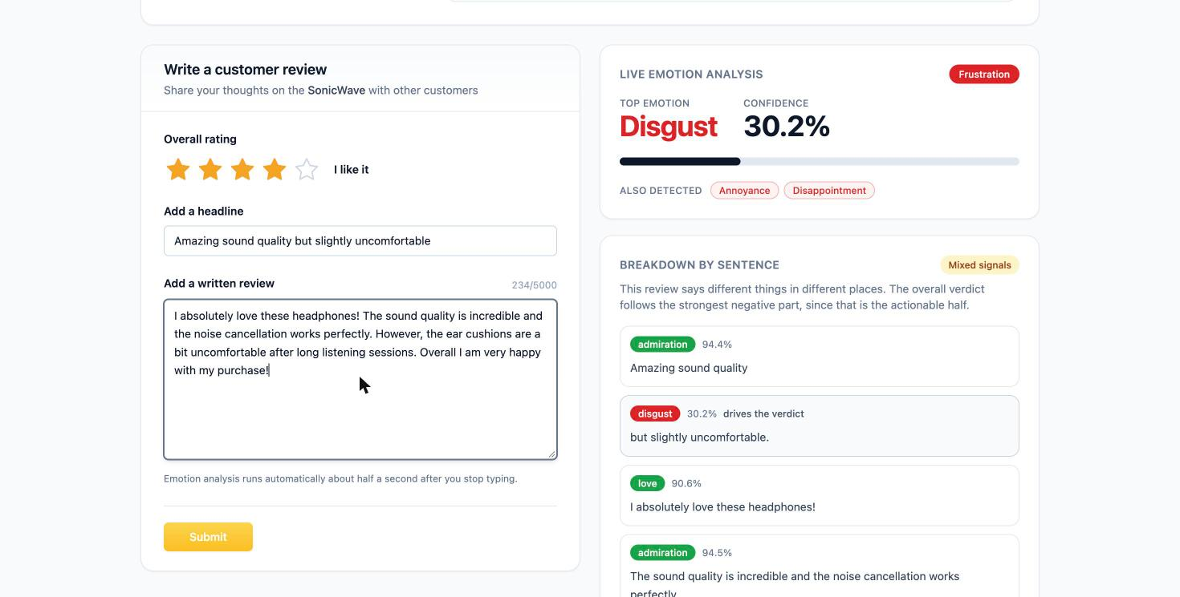
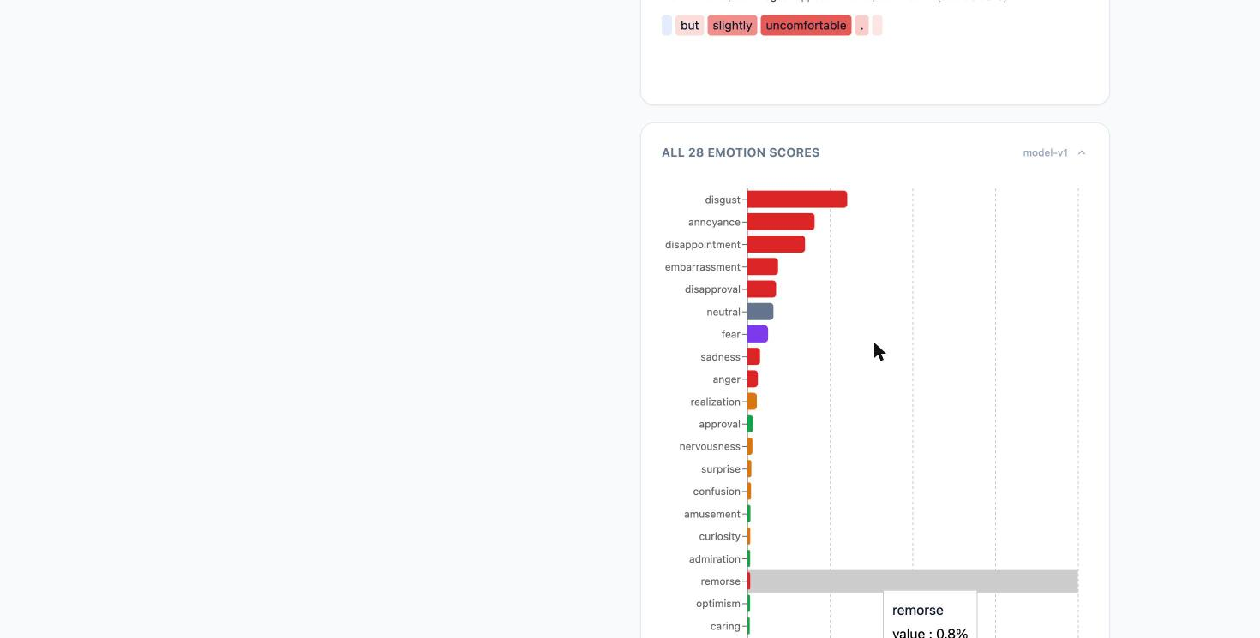
14 · IMPLEMENTATION: LIVE EMOTION ANALYSIS
Single-review analysis with 28-label output, sentence scoring and business bucket
TEST ENTRY USED
Product:
SonicWave Pro ANC
Star Rating:
**** (4/5)
Headline:
Amazing sound quality but
slightly uncomfortable
Review:
"The noise cancellation is
incredible and the sound
quality blew me away.
However, after wearing
them for 2 hours, my
ears start to ache."
Model Output:
Top Emotion: Disgust 30.2%
Bucket: Frustration
Also: Annoyance,
Disappointment
Live emotion analysis output
All 28 emotion scores (bar chart)
Key finding: A single review praising 'amazing sound quality' while mentioning 'slightly uncomfortable' triggers Disgust (30.2%) as the dominant emotion — mapped to the Frustration business bucket. This reflects the mixed-sentiment split: the complaint element outweighs the praise in the model's learned weighting.
16

Slide 15
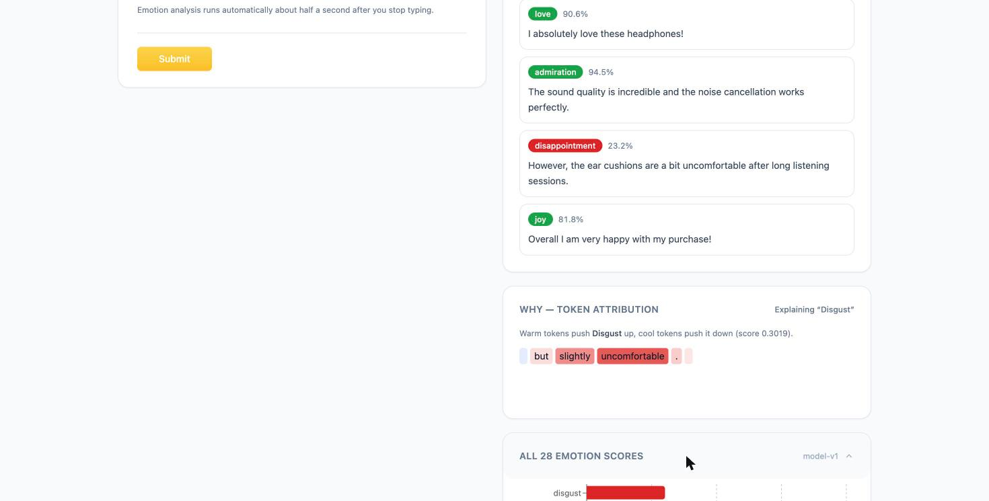
15 · EXPLAINABILITY: TOKEN ATTRIBUTION (XAI)
SHAP-style token-level explanations showing which words drove each emotion prediction
EXPLAINABILITY APPROACH
Method:
LIME / SHAP-style token attributions — computed using input perturbation over the RoBERTa encoder
What it shows:
Which tokens most strongly increase or decrease each predicted emotion score
Observed output:
"but" (light) → "slightly" (orange) → "uncomfortable" (red highlight) drive Disgust
Caching:
Attributions are stored in Redis; identical reviews skip recomputation
API endpoint:
GET /api/explain/{review_id} — returns per-token weights for each active label
Business value:
Reviewers and product managers can see exactly what language triggered each bucket classification
Token attribution — why "Disgust" was predicted
XAI FINDING: The contrastive connective "but" acts as a signal boundary — tokens after it ("slightly uncomfortable") receive higher attribution weights for negative emotions, validating the segment-aware scoring design.
17

Slide 16
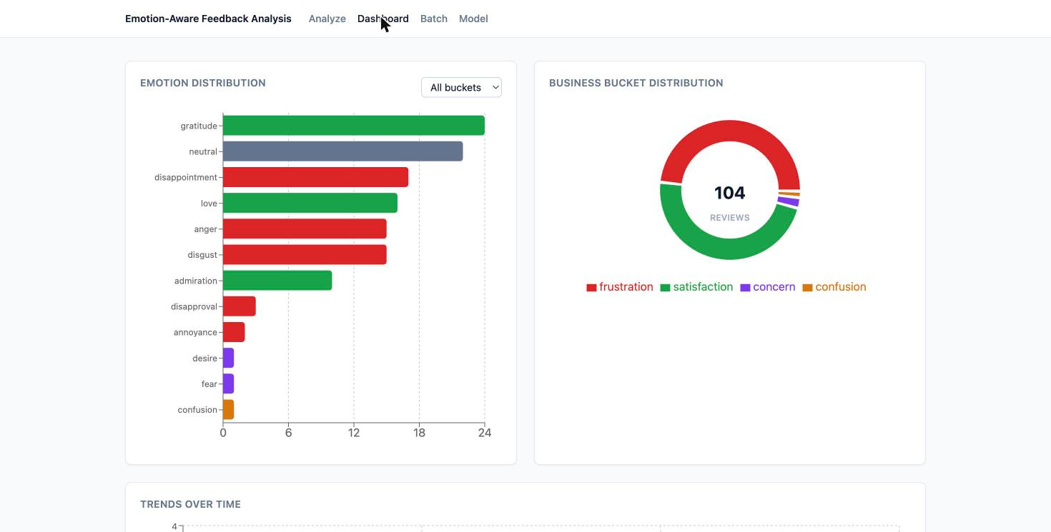
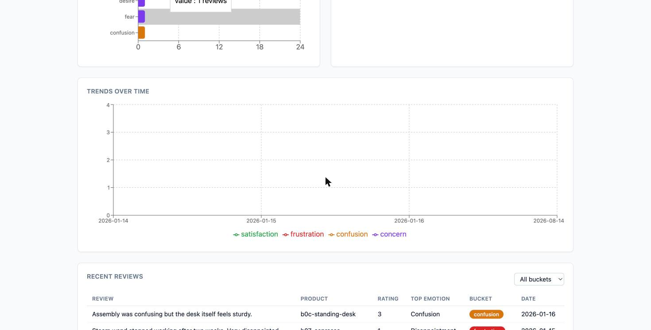
16 · DASHBOARD: ANALYTICS & TRENDS
Aggregated emotion distributions, business buckets, and time-series trends across 104 reviews
Emotion distribution + Business bucket donut (104 reviews)
Trends over time (Jan–Aug 2026) + Recent reviews table
104
28
Frustration
Jan–Aug 2026
PostgreSQL
Reviews
Analyzed
Emotion
Labels
Dominant
Bucket
Trend
Period
Persistent
Storage
18

Slide 17
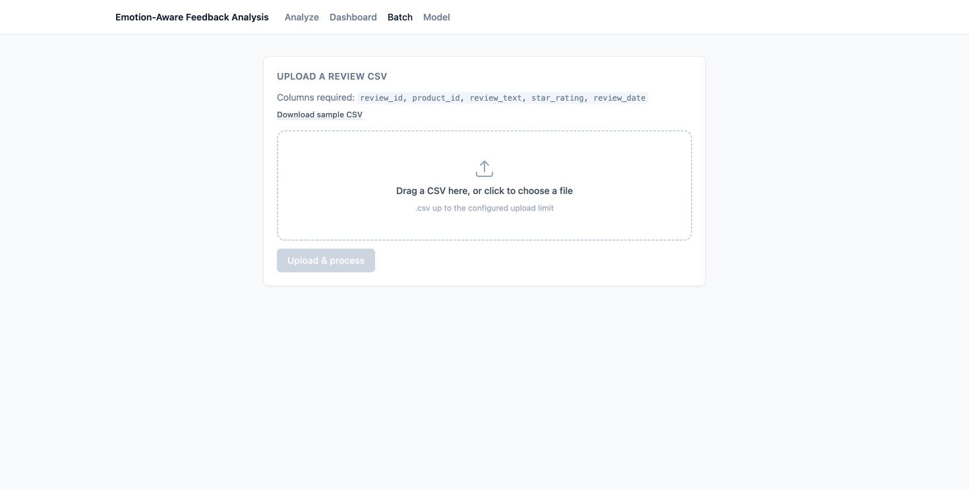
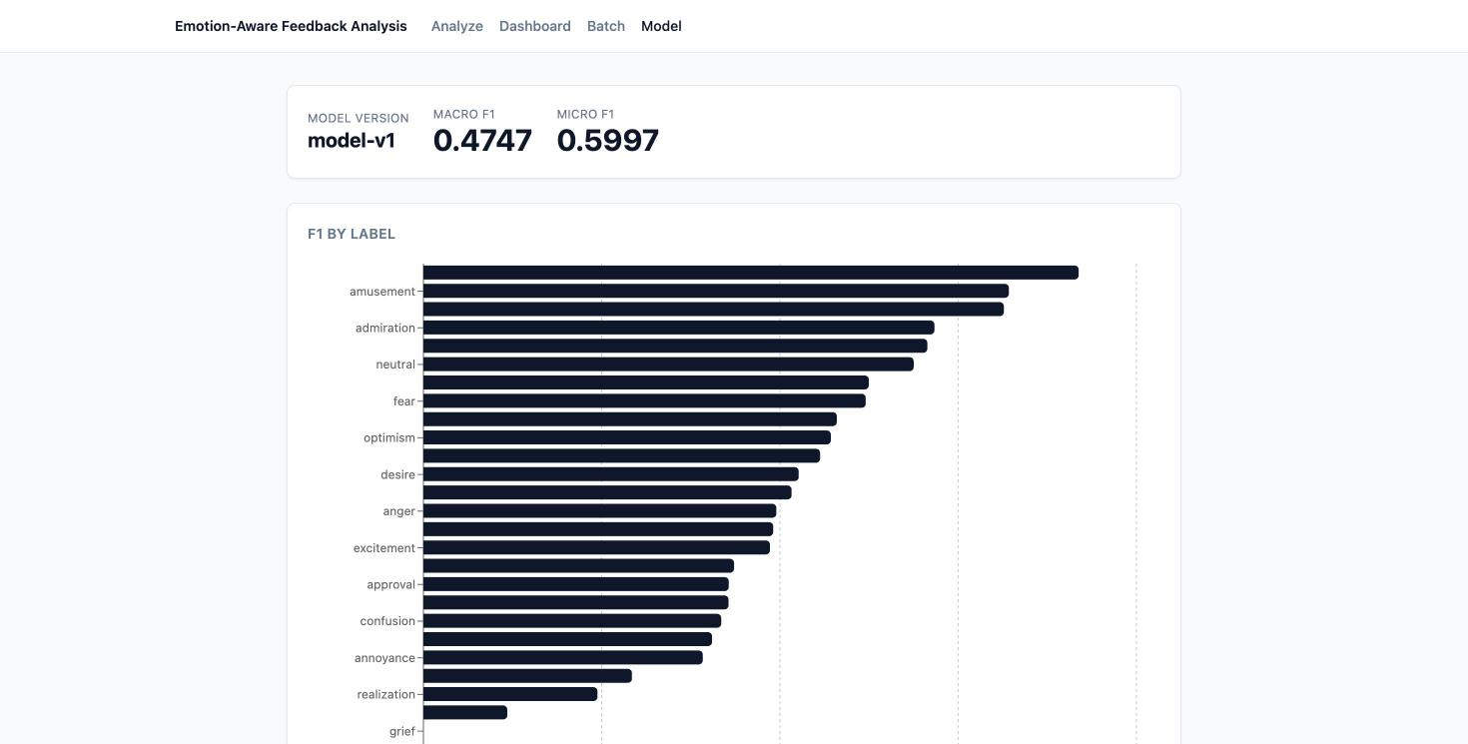
17 · BATCH PROCESSING & MODEL PERFORMANCE
Async CSV batch ingestion via Celery + model-v1 metrics: Macro F1 0.4747, Micro F1 0.5997
BATCH PROCESSING
MODEL PERFORMANCE
Accepts CSV with columns: review_id, product_id,
review_text, star_rating, review_date
Processing: Celery async worker · Redis task queue
Results stored in PostgreSQL for dashboard analytics
Model Version:
model-v1
Macro F1:
0.4747
Micro F1:
0.5997
Base Model:
RoBERTa-base (125M)
Training Data:
GoEmotions (58k Reddit)
19

Slide 18
12 · PROJECT TEAM
The people behind the build
Four members · Applied Machine Learning for Text Analysis (24ALT3101).
PS
SV
CS
YC
Pujith Krishna Soma
V Sriram
CH. G Sree Susheel
Yaswanth Chowdary
Roll No. 2420090069
Roll No. 2420090106
Roll No. 2420090124
Roll No. 2420090126
Deliverable: a fine-tuned 28-label model, FastAPI backend, React dashboard, 42-test suite and documented limitations.
Course: Applied Machine Learning for Text Analysis · 24ALT3101
14
Notes:
Introduce the four team members and their roll numbers, then move straight to the closing slide.

Slide 19
Fine-grained emotion, explained at the token level,
and aggregated into decisions.
28 labels
Segment-aware
SHAP-explained
4 business buckets
Thank you
Applied Machine Learning for Text Analysis · 24ALT3101
Notes:
Close on the one-sentence framing, then take questions.

